Slide 1
Welcome to (Insert County) (Insert Address) xxx-xxx-xxxx
(Insert Hours)
Monday-Friday
8:00 AM-5:00 PM
“Starting You On The Pathway To Success”
Notes:
Welcome, Introduction and Housekeeping.

Slide 2
Notes:
Ask the audience – “By a show of hands how many of you are familiar with the OhioMeansJobs center?” You can then ask the audience to tell you what they know about it if there is anyone raises their hand.
The OhioMeansJobs Center is a partnership of organizations that are designed to provide a full range of assistance services designed to meet your education, training, employment or supportive service’s needs, all in one location.
We are here to assist job seekers, youth, and employers with job search assistance, Employee recruitment, Job Training and much, much more.
Here you can make copies, print your resume, email employers and utilize the resources available to help in your job search at no cost. In Ohio we have centers who provide services across all 88 counties although the services available within the OhioMeansJobs Center will vary based on the local community
Today we will be informing you of what is available in our local center. If you have any questions about any of the topics we will discuss today please feel free to ask during the session or request to meet with someone after. Let’s get started!

Slide 3
Resource Room Services
Job Postings
Computer Access
Faxes, Phones, and Copier
Workshops
Employment Resources
Labor Market Information
Basic Services
Notes:
We provide 2 types of services here Basic Self-service and Individualized Staff assisted.
The Resource Room is the hub of the OhioMeansJob center.
The services available in the resource room include – (review all the exterior shapes.)
(Here you may want to have handouts for the variety of services and or workshops)

Slide 4
Staff Assisted Services
Career Counseling
Job Search & Employment Planning
Education / Training Services
Workshops
Skills / Work Aptitude Assessments
Referral to Partner Agencies
Individualized Services
Notes:
Staff Assisted Services are also referred to as Intensive Services.
Intensive Services may include – (Review all the exterior shapes.)
(Here you may want to have handouts for the variety of services and or workshops)

Slide 5
OhioMeansJobs.com
PLAY VIDEO
Notes:
OhioMeansJobs.com is Ohio’s online career and employment center.
Click on “Play Video” Link
Link Site: https://vimeo.com/97572627
Play above video –Stop at 7:36secs

Slide 6
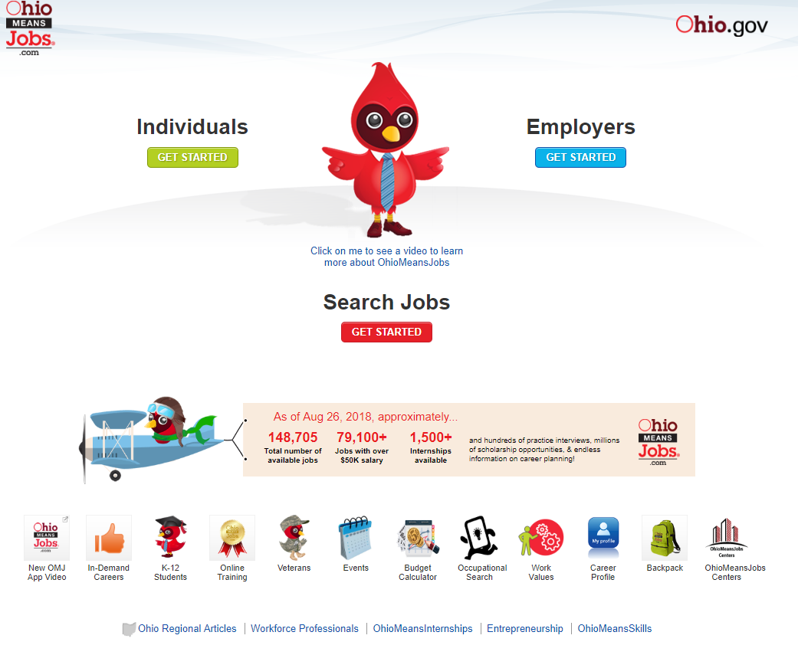
www.OhioMeansJobs.com
Notes:
Let’s begin with reviewing www.OhioMeansJobs.com.
Note: OhioMeansJobs.com is a resource for both job seekers and employers. For today’s session, we are going to focus on the Individuals Tab.
(If possible go live to demonstrate access)

Slide 7
The 1st Visit
Notes:
On the individuals tab, there are a variety of resources available to you 24 hours a day/7 days a week.
Let’s begin…
If you are seeking information about resources and tools for veterans, click on the Veteran hyperlink or Private Owen.
If you have recently filed for unemployment and are seeking to complete your House Bill 2 requirements – click on the Unemployment Insurance Claimants hyperlink for detailed instruction on how to complete. If you still run into issues, please reach out to a staff member in our resource room.
For Ohio Jobs and Family Services Programs: Food and Cash Assistance, child support and Trade Adjustment Assistance, click on the Job and Family Services portal.
For educational services and resources geared towards children in grades K-12, click on K-12 Student portal.
The next portal, OhioMeansAccessibilities was developed to provide resources for individuals with disabilities. Again, all the resources provided are for both job seekers and employers.
For our college students, the College Student portal provides career guidance, labor market information, career exploration and financial planning assistance.
The remaining rows of icons are a mix of resources and tools., most of which we will talk about in the next few slides. Additional icons I would like to identify are Adult Education, ApprenticeOhio and Bureau of Worker’s Compensation.
Adult Education provides information on Adult Diploma Programs.
ApprenticeOhio is a portal to information and resources about apprenticeships available across Ohio. What makes apprenticeships great is the fact you earn while building skills and learning at the same time.
Bureau of Compensation is a portal for resource material and information on how to navigate BWC.
At the bottom of the page there are additional pages for Workforce Professionals, OhioMeansInternships, and for those interested in starting your own business Entrepreneurship

Slide 8
Benefits of using the Back Pack
Create/update career plan
Electronic Storage – resume, cover letter, transcripts, etc.
Electronic record of job leads/status
Create multiple job searches
Financial Planning
Research OhioMeansJobs Center services
Skills/Work Aptitude Assessments
Stay organized – Calendar for events
Register for workshops & job fairs
Notes:
The first Icon on the first row was the Backpack. The Backpack is the symbol used for your individual account. Once you create an account, the tools you use on the website while logged into your account will be tracked. In a few slides, we are going to illustrate the easy way to begin this process.
Benefits of using the backpack are:
Create/update career plan – where are you? Where do you want to be? How do you get there? What needs to be completed? When does it need to completed?
Electronic Storage – resume, cover letter, transcripts, etc. You may not always have the documents on you, but can log into and print when needed.
Electronic record of job leads/status – document places you have applied to. This allows you to follow-up and or update the status as you interview, etc.
Create multiple job searches – can save up to 10 job searches based around your skills and experience.
Financial Planning by use of the budget calculator
Research OhioMeansJobs Center services – local partners and or researching training providers
Skills/Work Aptitude Assessments – TABE, WorkKeys, and other computerized assessments available in our Online Training Center
Stay organized/Calendar for events
Register for workshops & job fairs

Slide 9
The 1st Visit
Notes:
The easiest way to use OhioMeansJobs.com for your job search needs is through using the FirstUp! Guided Tour To get to the guided tour from the Individuals page you would click on the First Up! Guided Tour Icon as show on the screen.

Slide 10
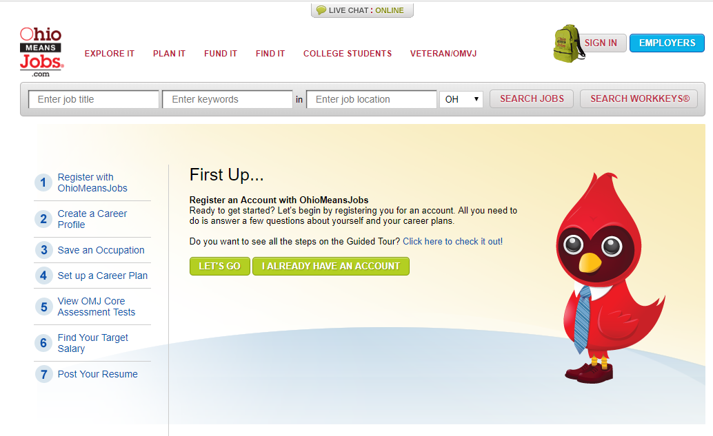
Notes:
If you are not sure where to start or how to navigate OhioMeansJobs.com the guided tour can help walk you through the job search and career planning process in 7 steps.
Step 1 of the guided tour will get you started by walking you through the process of creating an account on OhioMeansJObs.com. Once you have created an account on OhioMeansJobs.com you’ll be able to sign into your backpack at any time.
Step 2 will walk you through creating a Career Profile. The Career Profile interest assessment is a tool all about what you like to do. You will answer a series of questions about yourself and be given a breakdown of distinct aspects of your personality that help you identify industries that match your personal interests. You can use your results to learn about different careers, including in-demand jobs in Ohio.
In Step 3 you will use OhioMeansJObs.com to begin searching for occupations. You can also save the ones that suit you best and you are interested in researching further.
Step 4 will help you set up a career plan for any of the Occupations you selected in step 3. The career planning tool does this by assisting you in putting together a to-do list of activities geared to help you achieve your career goals. Once you identify activities for your career plan, you can save tasks, set deadlines and track your progress using the built-in calendar.
Step 5 will help you to learn your proficiency level in various skill areas as well as take other training tests that can help you to improve and build new skills for your career.
Step 6 uses the Budget Calculator to help you determine how much you need to earn to support yourself. After you complete the activity by making choices about a variety of expenses, it displays the salary required and options to explore occupations with similar salary ranges.
Step 7 The Resume tool allows you to upload an existing resume or create a new resume by answering questions about your learning and work experiences. You can also upload other important documents like certificates, references or essays. When you’re ready to apply for a job, you can use the online resume rater to get tips for improving your resume.
Once you complete the 7 steps of the guided tour you should be prepared to begin an informed and target job search.
You can access OhioMeansJobs.com using the computers in our resource room here or anywhere you have an internet connection. Next, we are going to talk about some of the other partners and programs that you may be interested in.

Slide 11
The 1st Visit
Notes:
Once you have completed the guided tour and are ready to begin your job search you will click on the Search Jobs Get started button.

Slide 12
Workforce Development
660 S. Main St. Dayton, OH 45402
(937) 461-4800
Business Skills and Customer Service Training
Placement Services
Senior Community Service Employment Program
Comprehensive Case Management for Youth Ages 16-24
Job Coaching
Vocal Assessments/Career Planning
SAMPLE
Notes:
Here you will transition into introducing the various partners and programs that are available in your OhioMeansJobs Center.
This is a sample of the information you want to include. It is best practice to provide attendees with a copy of the PowerPoint to ensure that the attendees have contact information for any program they may be interested in.
Slides 14 – 22 have been premade to ensure that the required partners are included. If there are additional programs or services offered they may be added in by simply duplicating the slide and personalizing the information.

Slide 13
VETERANS
Name: Local Veteran Service Office
Address: 123 Street
City, State, Zip
Phone: (###) ###-####
Website:
Insert Services
Priority of Service
____________________
____________________
____________________
Insert Partner’s Logo
Notes:
Ask “Are there any veterans in the room today?” If yes thank them for their services and then explain that we are proud to offer priority service to U.S. Military Veterans and eligible spouses for the receipt of employment, training, and placement services.
If there is a local Veteran’s Services office/program in or near your OhioMeansJobs Center, insert their information on this slide.
Examples may include: Veteran Affairs, Ohio Strong, ODJFS Veterans Services, Feds Hire Vets, Veterans Job Bank, State Approving Agency (SAA) for Veterans Training, etc.
If there are additional Veteran resources or contacts add additional slides.
If there are not resources available for Veterans please delete this slide.

Slide 14
YOUTH PROVIDERS
Name: Youth Career Services
Address: 123 Street
City, State, Zip
Phone: (###) ###-####
Website:
Insert Services
Comprehensive Case Management and Employment Program (CCMEP)
_____________________
_____________________
Insert Partner’s Logo
Notes:
If there is a local Youth Career Services office/program in or near your OhioMeansJobs Center, insert their information on this slide.
Examples may include: YouthWorks, Young Adult Resource Center (YRC), JobCorps, Co-Op Internship Program (Ohio Means Internships), etc.
If there are additional Youth resources or contacts, add additional slides.
If there are not resources available for Youth please delete this slide.

Slide 15
MATURE WORKERS
Name: Older Worker Program
Address: 123 Street
City, State, Zip
Phone: (###) ###-####
Website:
Insert Services
____________________
____________________
____________________
Insert Partner’s Logo
Notes:
If there is a local Mature Services office/program in or near your OhioMeansJobs Center, insert their information on this slide.
Examples may include: The Senior Community Service Employment Program (SCSEP), “Journey Through Aging” radio Program, Vantage Workforce Solutions, Workforce 50, etc.
If there are additional Mature Worker resources or contacts, add additional slides.
If there are not resources available for Mature Workers please delete this slide.

Slide 16
DISABILITY RESOURCES
Name: Opportunities for Ohioans with Disabilities (OOD)
Address: 123 Street
City, State, Zip
Phone: (###) ###-####
Website:
Insert Services
____________________
____________________
____________________
Insert Partner’s Logo
Notes:
If there is a local Disability office/program in or near your OhioMeansJobs Center, insert their information on this slide.
Examples may include: Opportunities for Ohioans with Disabilities (OOD), Ohio Department of Developmental Disabilities (DODD), Bureau of Services for the Visually Impaired, the Bureau of Vocational Rehabilitation, etc.
If there are additional Disability resources or contacts, add additional slides.
If there are not resources available for individuals with disabilities please delete this slide.

Slide 17
RESTORED CITIZENS
Name: Restored Citizen Program
Address: 123 Street
City, State, Zip
Phone: (###) ###-####
Website:
Insert Services
____________________
____________________
____________________
Insert Partner’s Logo
Notes:
If there is a local Restored Citizens office/program in or near your OhioMeansJobs Center, insert their information on this slide.
Examples may include: Ohio Ex-Offender Reentry Coalition, Second Chance Grant, The EXIT Program, Columbus Urban League, Youth Transitional Program (YTP), North Star Reentry, etc.
If there are additional Restored Citizens resources or contacts, add additional slides.
If there are not resources available for Restored Citizens please delete this slide.

Slide 18
WIOA
Name: Workforce Innovation & Opportunity Act (WIOA)
Address: 123 Street
City, State, Zip
Phone: (###) ###-####
Website:
Insert Services
____________________
____________________
____________________
Notes:
If there is a local WIOA contact for the program in or near your OhioMeansJobs Center, insert their information on this slide.
Examples may include: WIOA Adults, Dislocated Workers, Youth, etc.
If there are additional WIOA resources or contacts, add additional slides.
If there are not resources available for WIOA please delete this slide.

Slide 19
EMPLOYER SERVICES
Name: Employer’s Contact/Name
Address: 123 Street
City, State, Zip
Phone: (###) ###-####
Website:
Insert Services
____________________
____________________
____________________
Insert Partner’s Logo
Notes:
If there are Employer Services office/programs in or near your OhioMeansJobs Center, insert their information on this slide.
Examples may include: Job Fairs, Onsite Hiring, On the Job Trainings (OJT), Temp Agencies, etc
If there are additional Employer Services resources or contacts, add additional slides.
If there are not resources available for Employer Services please delete this slide.

Slide 20
COMMUNITY SERVICES
Name: Local Community Service Office
Address: 123 Street
City, State, Zip
Phone: (###) ###-####
Website:
Insert Services
____________________
____________________
____________________
Insert Partner’s Logo
Notes:
If there is a local Community Services office/program in or near your OhioMeansJobs Center, insert their information on this slide.
Examples may include: Community Action, Goodwill Easter Seals, WorkReady, etc.
If there are additional Community resources or contacts, add additional slides.
If there are not resources available for Community Services please delete this slide.

Slide 21
EDUCATION
Name: Local Community Service Office
Address: 123 Street
City, State, Zip
Phone: (###) ###-####
Website:
Insert Services
____________________
____________________
____________________
Insert Partner’s Logo
Notes:
If there is a Educational office/program or school in or near your OhioMeansJobs Center, insert their information on this slide.
Examples may include: ASPIRE, ESAL, local Community Colleges, local Universities, etc.
If there are additional Educational resources or contacts, add additional slides.
If there are not resources available for Education please delete this slide.

Slide 22
Notes:
Give the audience time to ask any questions they may have.

Slide 23
Next Steps
Notes:
Here you may want to pass out registration packets for anyone who wishes to register for the OhioMeansJobs Center Services – You can explain how they log in and out every time they visit the center.
Encourage the audience to go to the resource room to begin their job search and career plan by registering on OhioMeansJobs.com.
They may want to begin the process to meet with a particular partner/program.
Provide all of the centers contact info.
If applicable provide a short tour of facility.

